Slide 1
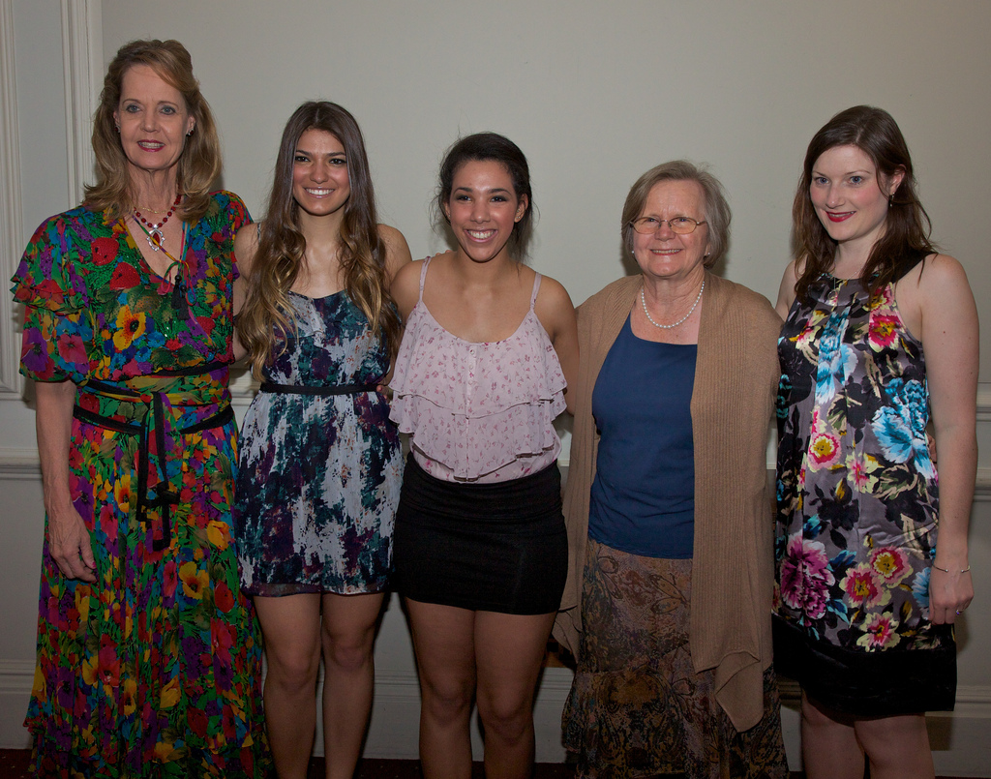
Friends
Friends
Grandma_grandchild

